Slide 1
Introduction to linear regression

Slide 2
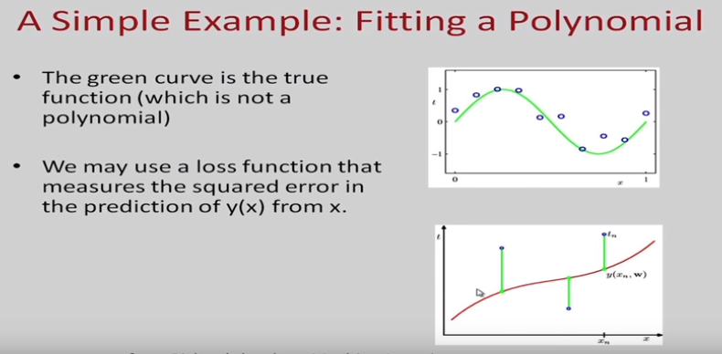

Slide 3
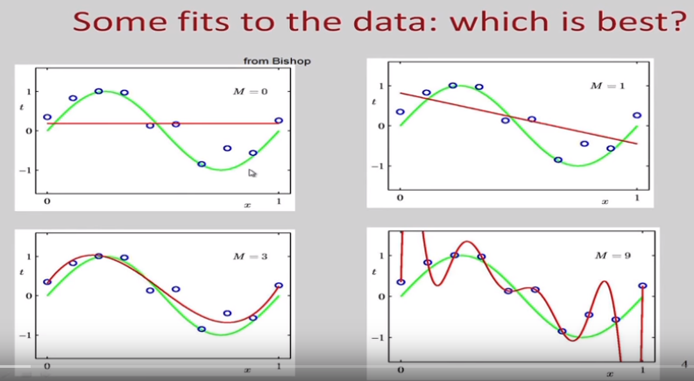



Slide 4
Defnition of regression
Regression analysis is the process of constructing a mathematical model or function that can be used to predict or determine one variable by another variable or variables.

Slide 5
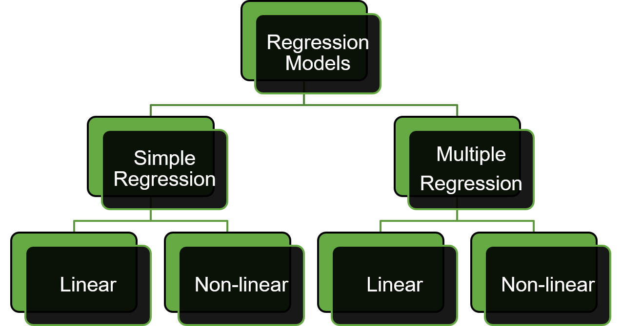
Types Of Regression
One independent variable
More than one independent variable

Slide 6
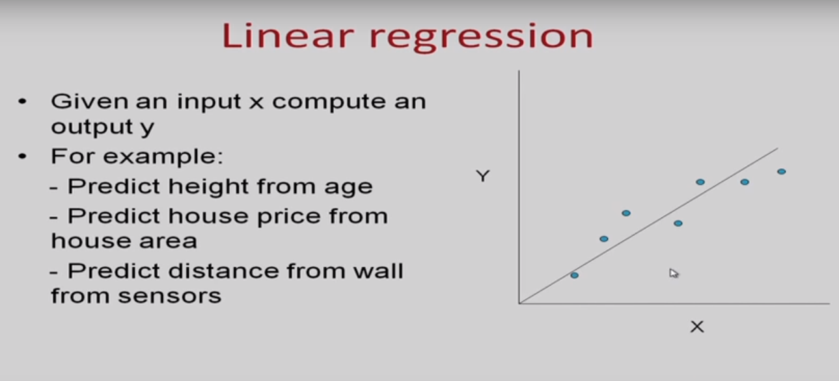





Slide 7
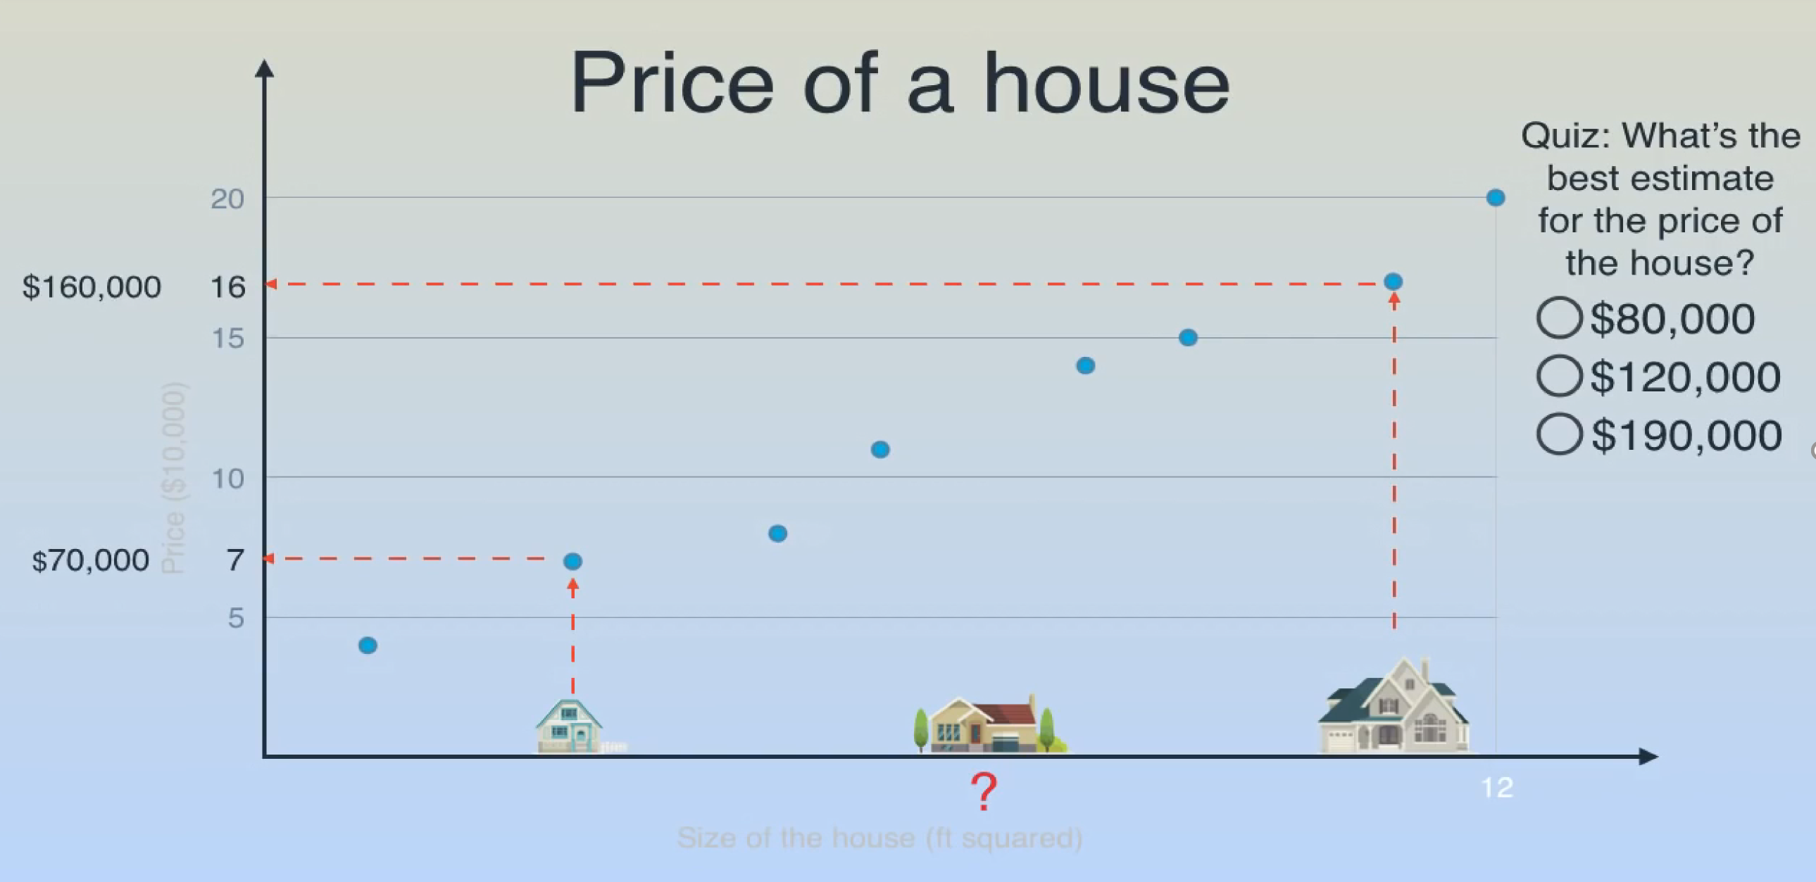


Slide 8
Linear Regression
Linear regression is a simple approach to supervised learning, as it assumes that the dependence of Y on X₁, X₂,…,X_{p} is linear.
A linear relationship suggests that a change in response Y due to one unit change in X is constant, regardless of the value of X.
In statistics, linear regression is an approach for modeling the relationship between a scalar dependent variable y and one or more explanatory variables (or independent variables) denoted X. The case of one explanatory variable is called simple linear regression.

Slide 9
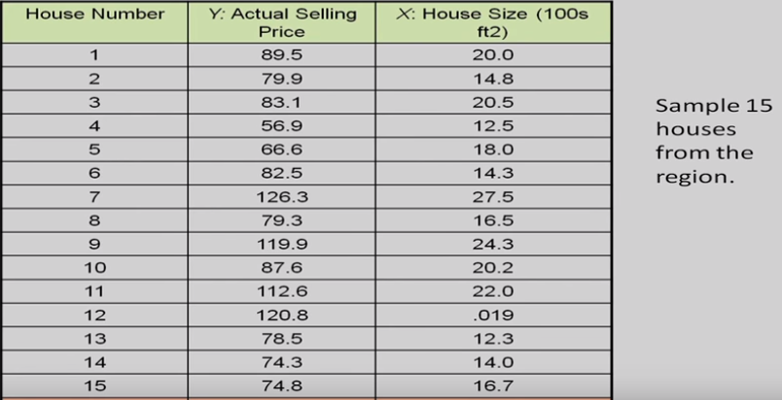

Slide 10
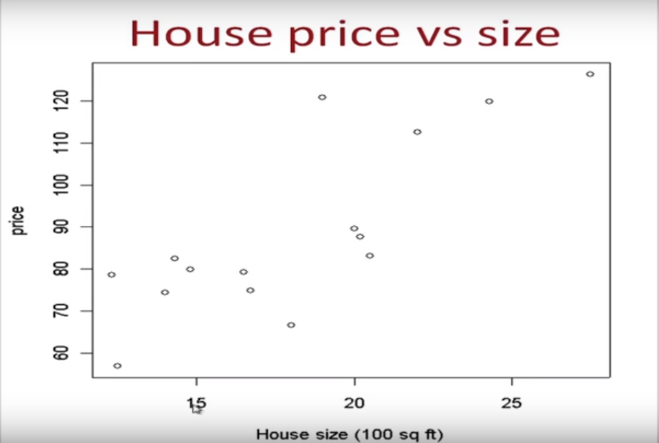

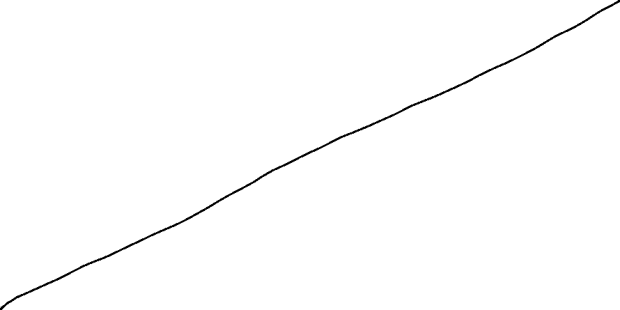


Slide 11
Sample Regression Function
(continued)
Y
Observed Value of y for xi
e_{i}
Slope = b₁
Predicted Value of Y for X_{i}
Random Error for this x value
Intercept = b₀
x_{i}
X

Slide 12
Sample Regression Function
Estimate of the regression intercept
Estimate of the regression slope
Independent variable
Error term
Two parameters to estimate – the slope of the line b1 and the y-intercept b0 (where the line crosses the vertical axis).
e is the unexplained, random, or error component.

Slide 13
The error term (residual)
Represents the influence of all the variable which we have not accounted for in the equation
It represents the difference between the actual "y" values as compared the predicted y values from the Sample Regression Line

Slide 14
Our Objective
To Predict PRL from SRL
From the sample of values of x and y, estimates b0 of β0 and b1 of β1 are obtained using the least squares or another method.
The symbol “^” is termed “y hat” and refers to the predicted values of the dependent variable y that are associated with values of x, given the linear model.

Slide 15
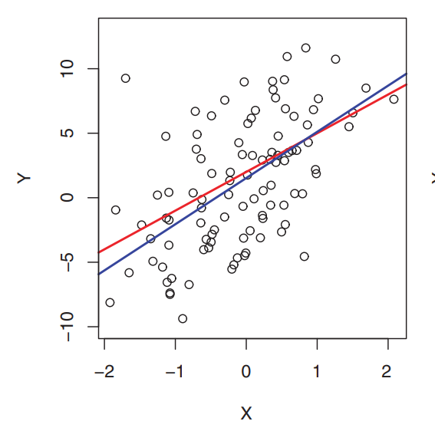
Ordinary Least Squares Estimation
Ordinary least squares (OLS) or linear least squares is a method for estimating the unknown parameters in a linear regression model, with the goal of minimizing the differences between the observed responses and the responses predicted by the linear approximation of the data.
The red line represents the true relationship, f(X)=2+3X, which is known as the population regression line. The blue line is the least squares line; it is the least squares estimate for f(X) based on the observed data, shown in black.

Slide 16
Ordinary Least Squares Estimation
Visually this is seen as the sum of the vertical distances between each data point in the set and the corresponding point on the regression line - the smaller the differences, the better the model fits the data.
b0 and b1 are obtained by finding the values of b0 and b1 that minimize the sum of the squared residuals
Are there any advantages of minimizing the squared errors?
Why don't we take the sum?
Why don't we take absolute values instead?

Slide 17
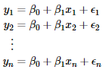
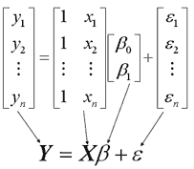
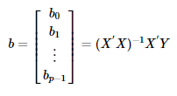
This approach treats the data as a matrix and uses linear algebra operations to estimate the optimal values for the coefficients.

Slide 18
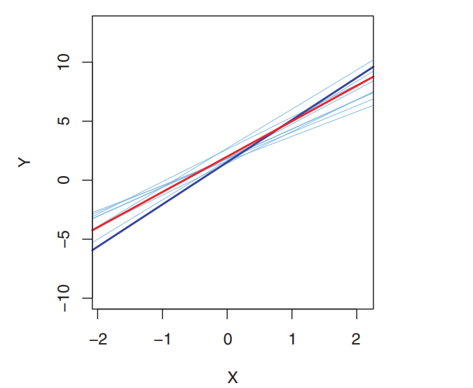
OLS Regression Properties
The sum of the residuals from the least squares' regression line is 0.
The sum of the squared residuals is a minimum.
Minimize ( )
The least squares coefficients are unbiased estimates of β₀ and β₁

Slide 19
Assumptions of Linear Regression
Linearity:- There should be a linear relationship between dependent (response) variable and independent (predictor) variable(s).
Residuals Mean should be equal to zero
No Autocorrelation of residuals:- Error terms should be Independent, i.e. there should be no correlation between the residual (error) terms. Absence of this phenomenon is known as Autocorrelation.
No Multicollinearity:- The independent variables should not be correlated. Absence of this phenomenon is known as multicollinearity.
Equal Variance:- The error terms must have constant variance. This phenomenon is known as homoscedasticity. The presence of non-constant variance is referred to heteroscedasticity.
Normality:- The error terms must be normally distributed.
Note:- If any of the above assumption is not met or violated then the predictions will be incorrect or unreliable
Notes:
Auto correlation mean correlation of a variable with its lag. When residuals are auto-correlated it means the current error values are dependent on previous error values. It is mostly applicable for Time series forecasting problems.
2)mean(fit$residuals)
3)acf(fit)
4)Library(car)
Vif(fit)
5)plot(fit)
6)plot(density(fit$residuals)) or normal q-q plot

Slide 20
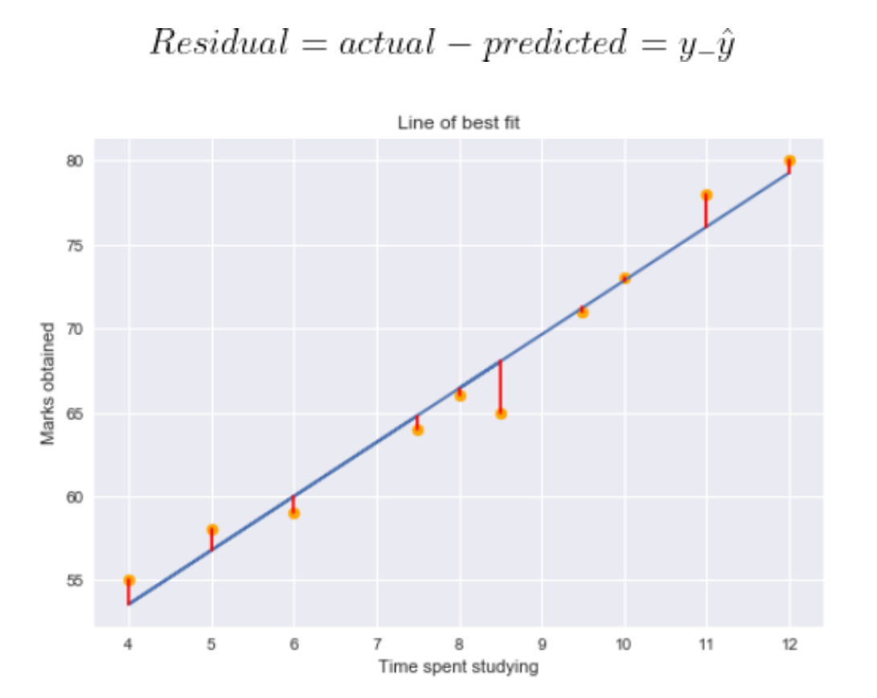
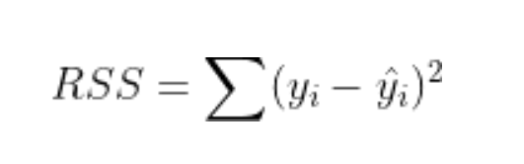
Residual
Residual for a point in the data is the difference between the actual and the predicted value by our linear regression model.
Using the residual values, we can determine the
sum of squares of the residuals also known as
Residual sum of squares or RSS.
RSS is also referred to as Sum of squared errors (SSE)
RSS gives us the variation in the target variable
that is not explained by our model.

Slide 21
Explained and Unexplained Variation
y
y_{i}
SSE = Sum of squared errors
∧
∧
y
SSE = ∑(y_{i} - y_{i} )²
SST = Total Sum of Squares
_
SST = ∑(y_{i} - y)²
∧
y
_
∧
_
RSS = ∑(y_{i} - y)²
_
y
y
RSS = Regression sum of squares
x
X_{i}

Slide 22
Explained and Unexplained Variation (Cont…)
(continued)
SST = Total sum of squares
Measures the total variation in Y
SSE = Sum of squared errors
the variation in Y not explained by X ,i.e. Variation attributable to factors other than the relationship between x and y
SSR =TSS -SSE
SSR = Regression sum of squares
Explained variation attributable to the relationship between x and y

Slide 23
Explained and Unexplained Variation (Cont…)
Total variation is made up of two parts:
Where:
= Average value of the dependent variable
y = Observed values of the dependent variable
= Estimated value of y for the given x value
Regression Sum of Squares
Also known as
Square Sum of Regression SSR
Total sum of Squares
Sum of Squared Errors

Slide 24
R-Squared
A metric you can use to quantify how much dependent variable variation is explained by the linear model. In other words, R-squared gives the degree of variability in the target variable that is explained by the model explains
R-squared = (TSS-RSS)/TSS
= Explained variation/ Total variation
= 1 – Unexplained variation/ Total variation
it evaluates how closely y values scatter around your regression line, the closer they are to your regression line the better.
The range of R-Squared goes from 0% to 100%. The higher the R-Squared the better.

Slide 25
Coefficient of Determination, R²
The coefficient of determination is the portion of the total variation in the dependent variable that is explained by variation in the independent variable
R² is also referred as a measure of goodness of fit
The coefficient of determination is also called R-squared and is denoted as R²
where

Slide 26
Coefficient of Determination, R² (Cont…)
(continued)
Coefficient of determination
Note: In the single independent variable case, the coefficient of determination is
Where:
R2 = Coefficient of determination
r = Simple correlation coefficient

Slide 27
Examples of Approximate R² Values
y
R² = 1
Perfect linear relationship between x and y:
100% of the variation in y is explained by variation in x
x
R² = 1
y
x
R² = +1

Slide 28
Examples of Approximate R² Values
y
0 < R² < 1
Weaker linear relationship between x and y:
Some but not all of the variation in y is explained by variation in x
x
y
x

Slide 29
Examples of Approximate R² Values
y
R² = 0
No linear relationship between x and y:
The value of Y does not depend on x. (None of the variation in y is explained by variation in x)
x
R² = 0

Slide 30
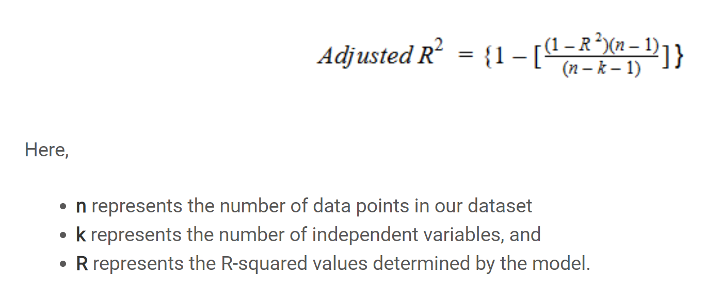
Adjusted R-squared
Adjusted R-Squared penalizes R-Squared values for including non-useful predictors, which adds very little information in explaining the variation in the target feature.
Adjusted R-squared considers the number of independent variables used for predicting the target variable. In doing so, we can determine whether adding new variables to the model actually increases the model fit.

Slide 31
Model Evaluation

Slide 32
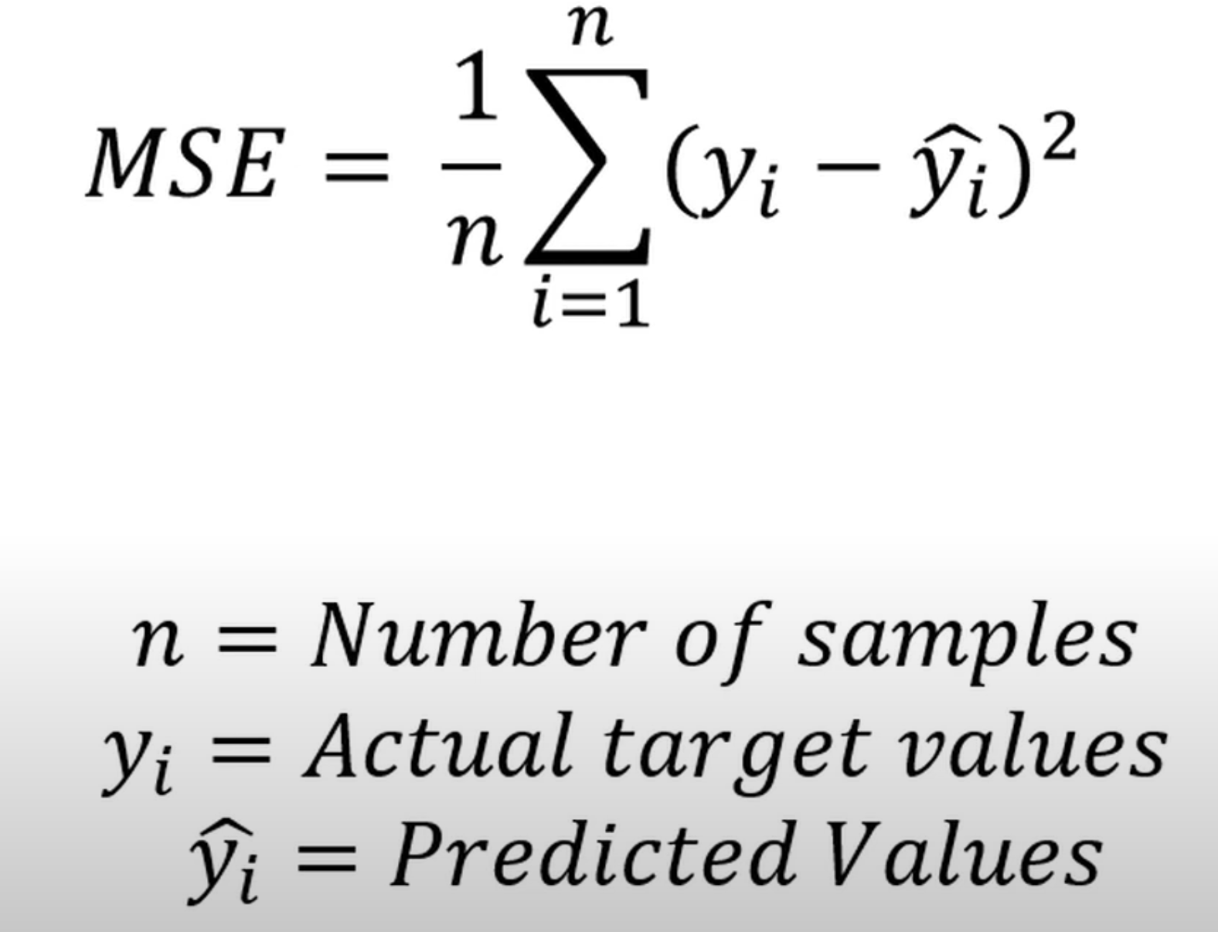
Mean Squared Error (MSE)
Mean Squared Error measures the average of the squares of the errors i.e. average squared difference between actual and the predicted value

Slide 33
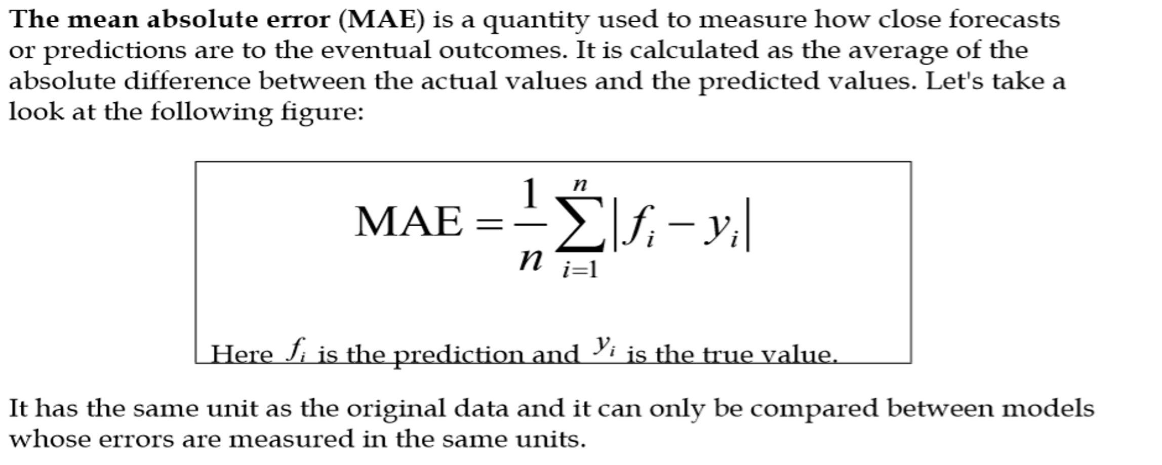
Mean Absolute Error (MAE)

Slide 34
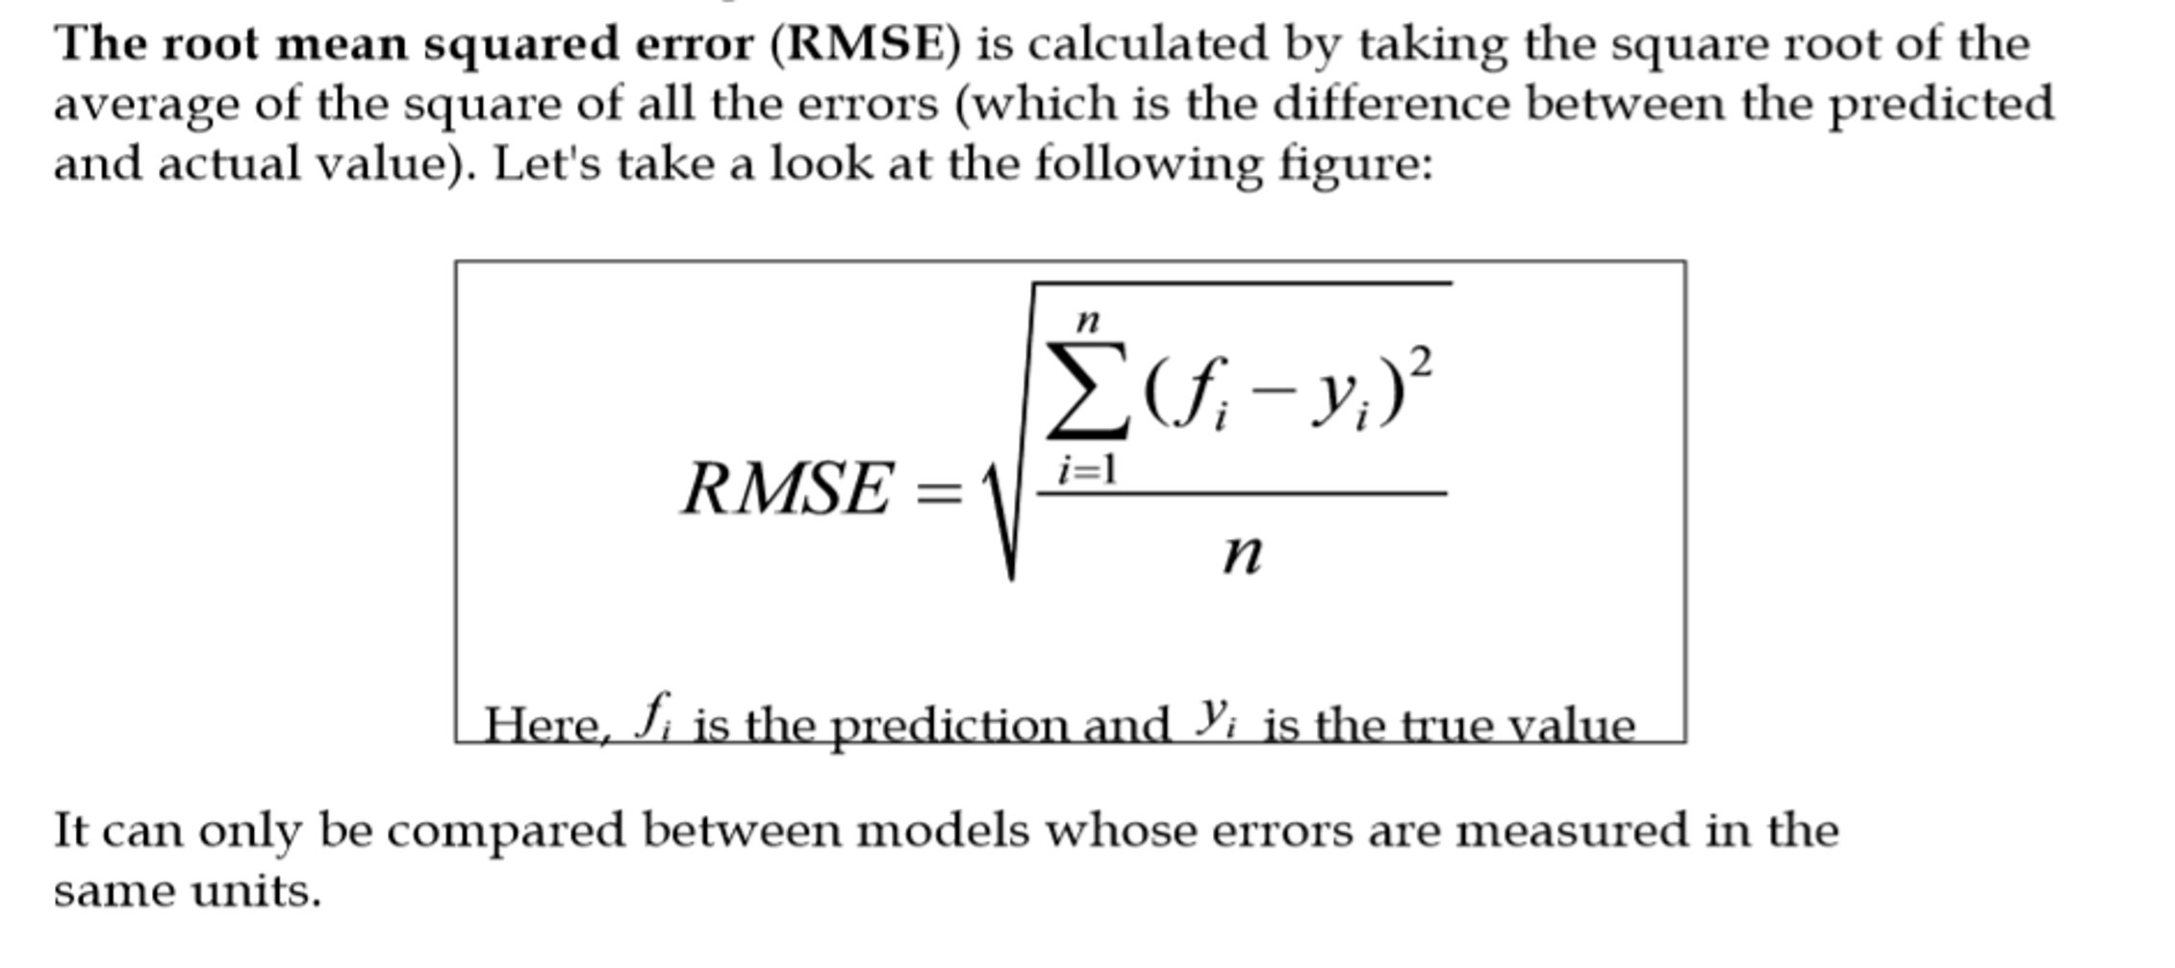
Root Mean Squared Error (RMSE)

Slide 35
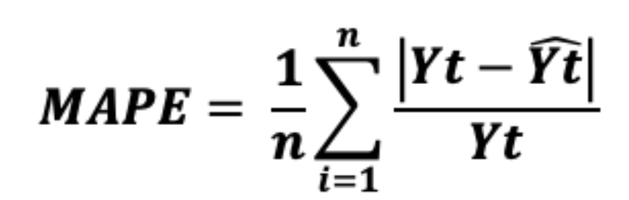
Mean Absolute Percentage Error (MAPE)
Mean absolute percentage error (MAPE) measures the predictive accuracy of models in terms of percentage. Mean absolute percentage error (MAPE) is the percentage equivalent of MAE

Slide 36
Which regression to apply where
Linear Regression :- if the assumptions are satisfied
Robust Regression :- Used to reduce the impact of outliers observations in input dataset
Ridge Regression :- if there is multicollinearity among the predictors
Lasso Regression :- if the number of predictors are more than observations
Elastic Net Regression :- if the beta coefficients are very large

